Slide 1
COURSE TITLE: TECHNICAL COMMUNICATION
COURSE CODE: FEG 401
UNIT: 1 UNIT
TIME OF LECTURE: 8 – 10 AM
DAY OF LECTURE: THURSDAY
LECTURER: DAVID, A. O.

Slide 2
COURSE SYNOPSIS
Professional use of English language for letters
Specification
Descriptions
Presentation of charts
Graphs
Tables
Writing of proposals in reports
Case studies of major professional presentation reports and proposals.

Slide 3
RECOMMENDED TEXTBOOK(S)
Advanced Academic Writing
By Abidoye, Luqman Kolawole
Terry Publishers

Slide 4
AIM
To provide students with technical writing and presentation skills necessary for effective report, project documentation and presentation.

Slide 5
OBJECTIVES
Students should acquire knowledge of various ways of data collection, primary and secondary data.
Students should develop ability for effective correspondence in the area of letter of application, letter of inquiry, and reply to letter of inquiry and memorandum report writing.
To gain insight in the use of illustrations given that engineers/scientists are mostly eye minded as oppose to word minded.
To develop effectiveness in thesis documentation.
To learn the rules guiding oral presentation.

Slide 6
INTRODUCTION
What is a Technical Report?
The question of “What is a Report” has no absolutely satisfactory answer. We talk of school reports, of newspaper reports, of laboratory reports, of law reports to mention but a few types. Have these anything in common?
One unique characteristic of a report is form.
What distinguishes a report-particularly, a technical report-from, say novel is that a report conveys specific information to a specific readers. It is not written because you happen to feel good one morning and want to reveal to mankind your particular joys.

Slide 7
WHAT IS A TECHNICAL REPORT CONT’D
A report is usually an answer to a question, or a demand from some other person for information:
What is the best way to control the erosion problems in Cross River State of Nigeria?
What are the chances of improving our gross national product?
I want to know why this metal is fracturing.
Get me a statement on the number of employees using the institute’s staff development scheme.
Technical writing is taken as an art of writing wherein scientists and engineers learn to express themselves lucidly, concisely and with precision.

Slide 8
WHAT IS A TECHNICAL REPORT CONT’D
Simply put, technical writing involves: clarity, completeness, accuracy, simplicity.
Also, technical writing is in part fulfilling the purpose of communication (Flow Chart-1).
Basic Definitions

Slide 9
WHAT IS COMMUNICATION
Communication is the meeting of the mind. It involves the mental preparedness & a conscious effort to listen.
It is also taken as a medium through which the goals of an organization, are achieved.
It is a means through which people share information, ideas, attitudes & feeling.

Slide 10
WHAT IS COMMUNICATION CONT’D
We need to improve communication... as 70 % of our communication efforts are:
misunderstood
misinterpreted
rejected
distorted or
not heard
Note: The majority of your perceived ability comes from how you communicate!

Slide 11
WHAT IS COMMUNICATION CONT’D
Communication is the process of sending and receiving information among people…
Feedback
receiver sender
SENDER Medium RECEIVER
Sender –Writer, Speaker, Encoder
Message –Information conveyed
Medium –Letter, Report, Presentation
Receiver –Reader, Listener, Decoder

Slide 12
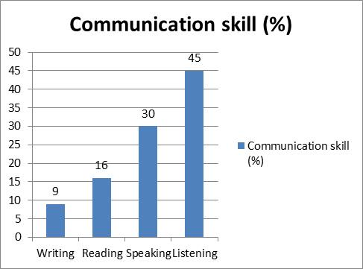
SKILLS REQUIRED FOR COMMUNICATION

Slide 13
WHAT IS COMMUNICATION CONT’D
In other words, in an organization communication makes it possible for each member to know what the others are doing.
Thus, policies, plans, procedures, strategies & goals are made known to the different levels of the organization through communication.
In other words, in an organization communication makes it possible for each member to know what the others are doing.
Thus, policies, plans, procedures, strategies & goals are made known to the different levels of the organization through communication.

Slide 14
FLOW CHART 1: PURPOSE AND FORM OF COMMUNICATION

Slide 15
PURPOSE AND FORM OF COMMUNICATION CONT’D
Forms of communication
Postcards, Letters & Memorandum
Essay, Articles, Pamphlets & Books
Instruction
Technical Reports, Description & Specification
Progress Report
Journal Publication for Research Work
Project/Dissertation/Thesis
Press Release
Book Review

Slide 16
1.2 What to Learn from Your Writing
To communicate most effectively, you must know the readers’ knowledge, needs, and attitudes.
Too much details will bore some readers but appear inadequate to others.
And if writing is a matter of tone and intentions as well as the mere conveying of information, it is important to know what are the reader’s feelings about the subject and therefore, what is the most tactful approach to adopt.

Slide 17
What to Learn from Your Writing CONT’D
Example case 1
Your letter of application, might be all an employer needs to decide whether you are suitable for a job or not. For individuals you have never met, they can judge you from your writing.
Also, students are judged by their course work-essays, records of experiments, field work, project reports and thesis and by their performance in written examinations.
In deed, your writing is one way you can give a good account of yourself as student, as an applicant for employment and as an employee.

Slide 18
What to Learn from Your Writing CONT’D
A note of caution anyone who writes poorly, is handicapped both in private study and in dealing with others (communication wise).

Slide 19
1.3 FORMS OF PERSONAL RECORDS
Note Taking During a Lecture
The style of delivering a lecture sometimes dictates the kind of notes taken by participants/students.
When a lecture is delivered in form of dictation, students make detailed notes but remember little.
In fact, students find it easier to make notes during a lecture if they have done some preliminary reading and if they have understood the earlier lectures in the same course.

Slide 20
FORMS OF PERSONAL RECORDS CONT’D
Note taking assists participants/students to remain attentive. Students must either listen to the lecture and then go to their books; or make notes as they follow the lecturer’s argument and explanation.

Slide 21
Keeping a Record of Practical Work
Laboratory and field studies are examples of work that require careful recording during specific investigation.
It is like keeping a diary for permanent records of daily activities, e.g. types of chemical or mixtures used, method adopted, temperature, pressure recorded.
Materials, methods and results should not be trusted to memory.
It may not be possible to write effective report if some details are omitted in the course of record keeping phase. Perhaps, this will mean waste of money and material resources invested in that project.

Slide 22
Keeping a Record of Practical Work CONT’D
Carefully prepared data sheets should be used to record information. Data sheets are aid to observation.
A Word of Precaution
Investigators are advised to keep a carbon copy of each page of their notes in a different file in case the original is lost. This practice will help in saving much time and money that went into the completed project.

Slide 23
Reporting an Experiment
An experiment can be reported using the following headings: Introduction, Materials and Methods, Results, Discussions and Conclusions and List of References.
If other headings are provided by your supervisor as more appropriate, they should be used. (see flow chart – 2).

Slide 24
Flow Chart 2: Summary of Experimental Reports

Slide 25
Flow Chart 2: Summary of Experimental Reports CONT’D

Slide 26
2. TECHNICAL TERMS, WORDS & ABBREVIATIONS
Highlight
One of the delights of English Language is its rich vocabulary.
No two words have quite the same meaning, and the choice of one word when some other words make more sense will not help the reader.
If you wish to be widely understood, try to express your thoughts in simply constructed sentences.
A word of caution: Scholarly writing must not be hard reading, also pompous style should not demonstrate to the world that the writers of such articles are educated.

Slide 27
2.1 Technical Terms
Technical terms are words that have a precise meaning in the language of science but they have additional meaning in common English usage (for example: allergy, neurotic, etc.).
The word “jargon” is commonly used in place of technical terms to describe specialist language that is only understood by a narrow circle of readers.
Technical terms are legitimate, if the user is only communicating with the reader who is in the same field and therefore familiar with the terms.
It is the specialist’s own type of shorthand.

Slide 28
Technical Terms CONT’D
It’s use saves pages of elaboration which would be necessary if the user had to communicate to a wider audience (mixed audience).
For any technical term to retain its value, scientists/engineers must use it correctly, that is, in the same way as other specialists.
If there is no internationally accepted definition, they should say whose definition they are following (and give this definition) or they should define the term to make clear their usage.
The use of any technical term must also be consistent throughout the report.

Slide 29
2.2 Use of Words and Vocabulary
Effective communication is in part a direct function of the volume of vocabularies at ones command.
We are limited in our ability to think by the number of words at our disposal or command.
Simply put, if we have a large vocabulary and can construct effective sentences and paragraphs, we are better able to express ourselves.
Writers are encouraged to prefer a short word to a long one (see Table 2.1) if the short word is more appropriate, and a single word to a phrase if brevity makes for clarity.

Slide 30
Use of Words and Vocabulary CONT’D
For meaning of words, the following points are noteworthy:
If more than one spelling is correct for any word (use of American or British Dictionaries), you should be consistent; in spelling, in the use of hyphens, and in the use of capital letters.
The habit of writing a word in inverted commas to indicate that it is not quite the right word, or that it is not used in the usual sense, or that more is implied than is said, is likely to confuse people. Instead, choose the word or words which convey your meaning precisely.

Slide 31
Use of Words and Vocabulary CONT’D
Like the measurements made by scientists, the following words, should contribute to precision in scientific writing:
Approximate (ly): means very close (ly) and should not be used when about or roughly would be better.
Data: refers to things given, to facts of any kind, such as the measurements which you record as numbers.
It is incorrect to speak of raw data or of real data; but it is correct to refer to your own observations as original data.
Results: are obtained by the analysis of data.
Statistics: are numerical data systematically collected.

Slide 32
Use of Words and Vocabulary CONT’D
The name statistics also refers to the science of collecting, clarifying and using statistics.
Range: Use this word only for the largest and smallest of a sample (or for the difference between these measurements).
Significant is a statistical term with a precise meaning. Scientists should try not to use it in other contexts.
Infer does not mean the same as imply. The writer or speaker implies something but the reader or listener infers.
Often: people who eat mushrooms often die (but people who do not eat them die only once).

Slide 33
Misuse of words
Many people misuse the following:
Alternatively (for alternately); alternatives (for more than two things); centre (for middle); centred around (for centred on); circle (for disc); degree (for extent); either (for each or both); except (for unless); generally (for usually); homogenous (for homogeneous); if (for although); improvement (for alteration); lengthy (for long); limited (for few, small, slight or narrow); major (for great); minor (for little); natural (for normal); optimistic (for hopeful); optimum (for highest); percentage (for some); provided that (for if); quite (for entirely or rather);

Slide 34
Misuse of words CONT’D
rudimentary (for vestigial); several (for some); same (for similar); singular or unique (for rare or notable); often (for in many places); always (for everywhere); sometimes (referring to place instead of time); superior (for better than); transpire (for happen); view (for opinion); virtually (for almost); volume (for amount); weather (for climate); wastage (for waste); and while (for although).

Slide 35
Changing time and meaning of words, Cont’d.
The meaning of words may change so much that they lose their value, and the incorrect meaning may come into common use.
The new usage may remain incorrect or it may gain acceptance but the scientist should not lead the way in giving new meanings to every-day words.
Consider the following:
Literally: a word used incorrectly to affirm the truth of an exaggeration.

Slide 36
Changing time and meaning of words, Cont’d.
Progress means a move forward, a change from worse to better, but the word is misused for change of any kind.
Sophisticated was once an uncomplimentary word implying sophistry and even artfulness but it now commonly used to mean complicated or to imply that a new instrument is in some way better than an earlier model.
Viable is a term which denotes the capacity to live, but in other contexts viable may mean too expensive or will not work.

Slide 37
Changing time and meaning of words, Cont’d.
Vital mean essential to life and should not be used in any other context.
Words with only one meaning should not be qualified, that is, unnecessary qualification of words (Table 2.2).
Facts, for example, are verified past events; things observed and recorded; data; things known to be true.
It is wrong, therefore, to refer to the fact that energy may be involved or to write that the evidence points to the fact or that someone has got his facts wrong, and to speak of the actual facts is to say the same thing twice (Table 2.3: Tautology).

Slide 38
Table 2.1: Use a short word instead of a long word if the short word is more appropriate.

Slide 39
Table 2.2: The unnecessary QUALIFICATION of words
Incorrect | Correct
absolutely perfect | perfect
The actual number | the number
an actual investigation | the investigation
Not actually true | untrue
Almost unique | not unique
almost perfect | imperfect
by means of | by or using
a categorical denial | a denial
completely surrounded | surrounded
conclusive proof | proof
cylindrical in shape | cylindrical
deliberately chosen | chosen

Slide 40
Table 2.3: Tautology – saying the same thing twice using different words
Every individual one; may possibly go; on Friday 28th November next; the reason for this is because; in actual fact; one after another in succession; in the rural countryside; as an extra added bonus; I tentatively suggest; in my own personal opinion; on pages 1- 4 inclusive; that by advance planning; will disappear from sight; in equal halves; in two equal halves; continue to remain.

Slide 41
2.3. Superfluous words and circumlocution
Superfluous words and circumlocution – imply the use of many words in a sentence where few would do better.
The use of too many words is a more common fault in writing than the use of wrong word; and while a summarizing or qualifying phrase may help the reader, any unnecessary words can only confuse, distract and annoy.
Furthermore, when too many words are used, time, paper and money are wasted in typing and advertising.
In revising, therefore, reconsider each sentence and each paragraph to see if it is necessary and prune sentences to remove all superfluous words (see Tables 2.4 and 2.5).

Slide 42
Laziness in sentence construction
Laziness in sentence construction (amongst the beginners in technical writing) may cause the writer to use jargon or to choose phrases made safe by common usage in preference to more appropriate words. Jargon may also ensue from attempts at elegant variation.

Slide 43
Writers are advised:
to prefer transitive verbs and use them in the active e.g. (“we obtained the following results –“not “the following results were obtained);
to prefer concrete nouns (things which you can see and touch) to abstract nouns; and
to prefer the direct word to the circumlocution.

Slide 44
Indicators of jargon are listed by Nwaogazie (2016) as:
Case, instance, character, nature, condition, persuasion, degree, area, angle, aspect, fact, field, level, situation, spectrum, time and type (see Tables 2.4 & 2.5).
Note that, there is nothing wrong with any of these words in its proper place.
Examples of introductory phrases and connectives are found in many technical reports.
Such can be deleted without altering the meaning of the sentence.

Slide 45
Consider the following:
a) Fig. 2 shows that -------
b) It is clear from a consideration of Fig. 2 that - - ----
introductory phrases (a) and not (b) are not necessary; and they may cause the reader to think that the figure shows only one thing.
It is better to say whatever you wish to say about the illustration and then to refer to the number of the figure (in parentheses), e.g.

Slide 46
Consider the following CONT’D:
The hydrograph generated from the 18 –year flood records (Fig. 2) depicts a skewed distribution. It is also unnecessary in the heading to a table or the legend to a figure, to write:
“Table showing ---- or Figure showing ----”.
Avoid the use of such words.

Slide 47
Table 2.4: Circumlocution – the use of many words where few would do better
Circumlocution | Better English
in virtually all sectors of the environment almost everywhere | almost everywhere
in black and white only | in black and white
if at all possible | if possible
peer group | equals
I myself would hope | I hope

Slide 48
Table 2.4: Circumlocution – the use of many words where few would do better CONT’D
I would have said | I think
you are in fact quite correct | you are right
mechanisms of physiological nature | physiological mechanisms
on an experimental basis | by experiment
on a dawn to dusk basis | from dawn to dusk
on a regular basis | regularly

Slide 49
Table 2.4: Circumlocution – the use of many words where few would do better CONT’D
It was observed in the course of the demonstration that … | We observed
There is really somewhat of an obligation upon us. | We should …
The committee was obviously cognizant of the problem. | The committee was aware of the problem.

Slide 50
Table 2.4: Circumlocution – the use of many words where few would do better CONT’D
An account of the methods used and the results obtained has been given by … | Their methods and results are described by
In no case did any of the seedlings develop lesions | None of the seedlings developed Lesions.
Such is by no means the case.…proved fatal in most cases. | This is not so. … killed most of them.

Slide 51
Table 2.4: Circumlocution – the use of many words where few would do better CONT’D
Even when the class is engaged in reading and writing activities … | Even when the children are reading and writing.
At the other end of the educational spectrum | In primary schools.

Slide 52
Abbreviations (l3)
Because abbreviation vary from country to country, abbreviations may have several meanings and the reader may not know which meaning the writer intended.
Thus, any essential abbreviation should be written in full when it is first used and then abbreviated in parentheses.
Authors should also be consistent in using abbreviations and in their punctuation.
Though names of journals are usually abbreviated in lists of references only essential abbreviations should be used.

Slide 53
Abbreviations CONT’D
Scientists and Engineers writing in English should try to convey their meaning without using phrases from another language, such as: loc. cit (in the place cited), op. cit (in the work cited) and ibid (in the same work) may contribute to ambiguity and they should not be used.
Furthermore, the use of abbreviations like i.e. (id est: that is); and e.g. (exernpligratia: for example), are misused and therefore misunderstood by some people.
The abbreviation e.t.c. (etcetera: and other things), used at the end of a list, conveys no additional information, except that the list is incomplete. It is better to write for example or including immediately before the list.

Slide 54
Abbreviations CONT’D
Many abbreviations are not punctuated (for example: WHO: World Health Organization) and punctuation marks should not be used with SI unit (International System of Units, see Table 2.6). Another rule is that an “S” should not be added to an abbreviation (except for nos: numbers; and figs: figures in the sense of illustrations).

Slide 55
Table 2.6: International System of Units (SI units)
Quantity | Unit | Symbol
Length | millimetre (0.001m) centimetre (0.01m) Metre Kilometre (1000m) | mm cm m km
Area | square centimetre square metre hectare | cm² m² ha

Slide 56
Table 2.6: International System of Units (SI units) CONT’D
Quantity | Unit | Symbol
Volume | cubic centimetre cubic metre | cm³ m³
Capacity | mililitre (0.001L) litre | ml l
Mass | gramme (0.001kg) kilogramme tonne (1000kg) | g kg t
Density | kilogramme per cubic metre | kg/m3

Slide 57
SUMMARY
For effective use of English language as an instrument for expressing and not for concealing thought, writer should (Orwell, 1950):
Be positive. Especially, avoid double negative such as not unlikely (for possible) and not unjustifiable.
Never use a metaphor, simile or other figure of speech which you are used to seeing in print.
Never use a long word where a short one will do.
If it is possible to cut a word out, always cut it out.
Never use the passive where you can use the active.

Slide 58
SUMMARY CONT’D
Never use a foreign phrase, a scientific word or a jargon word if you can think of an everyday English equivalent.

Slide 59
PROCESS OF TECHNICAL WRITING
Gathering Information and Ideas
Given a project or research topic to investigate, you are ready to commit time and resources to it, to enable you accomplish the task.
The first headache to overcome is the question of “what means should I use to gather information bearing on my problem so that I can carry out my intentions.”
You will usually have some choice.

Slide 60
GATHERING INFORMATION AND IDEAS CONT’D
However, you should not lose sight of the total possibilities, which include but are not limited to the following areas:
Calling upon your memory
Searching the Literature
Generalizing from particulars and particularizing from generalities.
Inspecting local sites and facilities
Administering a Questionnaire
Checking Customer Attitudes and Requirements
Interviews
Letters of Inquiry

Slide 61
GATHERING INFORMATION AND IDEAS CONT’D
Performing calculations and Analyses
Reviewing the Information Already Gathered.
Further discussion on some of the listed items are presented herein.

Slide 62
The Laymen
Who is the layman?
He is the bank clerk reading a Daily Times newspaper supplement story about groundwater geophysical survey in Ogun State.
He is the biologist with a doctorate degree reading an article in the Journal of Nigerian Society of Engineers entitled “The Nature of Metals”.
In short, the layman is every person once he is outside his own particular field of specialization.

Slide 63
THE LAYMEN CONT’D
For the layman, he is reading for interest.
He is reading to tune in more accurately on the universe.
He is much more concerned with what things do than how they work.
His main reason for reading is practical.
His interest is personal.

Slide 64
THE LAYMEN CONT’D
Background
The layman needs to be given background material in the subject.
You should assume he knows little or nothing about the specialty.
An example of simplified introduction to a layman is that from an article on Atomic Energy in use, taken from literature.
“Light is radiation that we can see.
Heat is radiation that we can feel.
Radio and Television waves and X-rays are electromagnetic waves of radiation that we can neither see nor feel, but with whose usefulness we are well acquainted.
Now we are hearing more and more about another kind of radiation as a result of man’s continuing scientific and engineering achievements.

Slide 65
THE LAYMEN CONT’D
This is nuclear radiation.
Nuclear radiation consists of a stream of fast-flying particles or waves originating in and coming from the nucleus, or heart, of an atom.
It is a form of energy we have come to call atomic, or nuclear energy”

Slide 66
THE LAYMEN CONT’D
Definitions:
Laymen need specialized words and terms defined.
Simplicity:
Background and definition will help to keep an article simple for the layman.
However, avoid frequent use of specialized words for which you can find simple substitute.
Illustrations:
Use of charts, graphs, pictures will be helpful.

Slide 67
The Executive
Much of what has been said about the layman applies directly to the executive.
You cannot assume that the executive possesses very much knowledge in the field you are writing about.
While most executives have college degrees and many have technical experience they represent many disciplines and not necessarily the one you are writing on.
Some may have little technical knowledge but have been trained in management, psychology, social science or the humanities.

Slide 68
The executive cont’d
He is more concerned with what things do than with how they work.
He wants to know what effects a technological development will bring. He needs simple background.
However, he probably wants a bit more technical background than does the layman.
The executive will want most purely technical terms defined for him.
You should avoid shop jargon when addressing him.
He is a busy man, don’t force him to a dictionary any more than you would for a layman.

Slide 69
The executive cont’d
As you write for the executive use plain language, using sentences averaging about 20 words.
Avoid mathematics. Use simple illustrations of the type suitable for laymen: bargraphs, pie charts, and pictographs.

Slide 70
The expert
Who is the expert?
For our purpose, the expert is taken as a senior scientist or engineer with either an M.Sc. or a Ph.D. in his field or a B.Sc. and many years of experience.
He may be a university professor, an industrial researcher, or engineer who designs and builds.
Whichever of these he is, he knows his field intimately.
When he reads in his own field, he seldom looks for background information.

Slide 71
The expert CONT’D
You may give him background that you feel is particularly pertinent to the narrow subject at hand – such as a review of the experiments leading up to one you have conducted.
As you write for the expert you may use any shorthand methods such as abbreviations, mathematical equations, chemical formulas, and scientific terms that you are sure your audience can comprehend.

Slide 72
The expert CONT’D
You do not have to define terms unless you have used them in some new or unusual way.
Complicated formulas and equations needed to support the conclusions, but not essential for understanding them, are often not placed in the body of the report.
Modern practice more often places them in an appendix.
Tables provide an excellent way to lift classifications and groups of closely related facts out of the text and display them clearly

Slide 73
THE EXPERT CONT’D
The graphs used most often are line graphs.
They best portray the relationship between variables.
Map and photographs of unusual equipment also aid the expert reader significantly.
When you draw inferences from your facts and observations be sure to make no unwarranted leaps.
Stay within the bounds of the scientific method.

Slide 74
The expert cont’d
In presenting your conclusions be careful in your language to show where you are certain and where you are in doubt.

Slide 75
The technician
The technician is the man at the head of any operation.
He is the man who finally brings the scientist’s imaginative research and the engineer’s calculations and drawings to life.
He builds equipment and after it is built, he maintains it. He is an intensely practical man, perhaps with years of experience behind him.
The technicians’ educational level varies. HND, experienced secondary school leaver, …….

Slide 76
The combined audience
The most difficult audience for a technical writer is the combined perhaps composed of executive, experts, and technicians.
Yet in an industry, such an audience is a common one.
How do you avoid bombarding the manager with details and at the same time satisfy the needs of the experts?
The best approach to the problem is to consider how your readers will use the report.

Slide 77
Elements of scientific writing
Explanation, clarity, completeness, impartiality, order, accuracy, objectivity and simplicity are given here as basic requirements in scientific writing.
The writings of considerate authors have these and other characteristics.

Slide 78
Unscientific writing
Example 1
The complaint of examiners that students cannot write good English applies, I think, mainly to science students … As their abilities lie outside literature, it is not surprising that science students write badly.

Slide 79
Unscientific writing cont’d
Some faults
An opinion is expressed and later stated as a fact.
The author gives no evidence in support of the implication that students are good at either literature or science.

Slide 80
description, presentation of charts, graph and Tables
Case study of final year student project:
Procedure
Open a new file in Microsoft word
Choose the font size and type under “Home” (Figure 1)
Press Enter (severally) to get into page two (Figure 2)
Configure Preliminary pages and the main body by using page break under “Page Layout” . Move the cursor to page one , then double click to show footer – section I and header – section II (Figures 3 & 4)

Slide 81
description, presentation of charts, graph and Tables CONT’D
5. Save the file by clicking on file, scroll down to “save as” (Figure 5)
6.

Slide 82
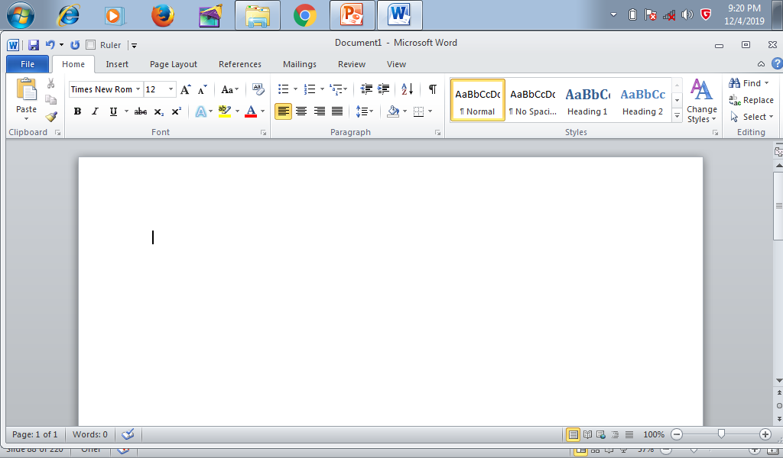
MICROSOFT WORD REPORT PRESENTATION
Figure 1: Formatting project file

Slide 83
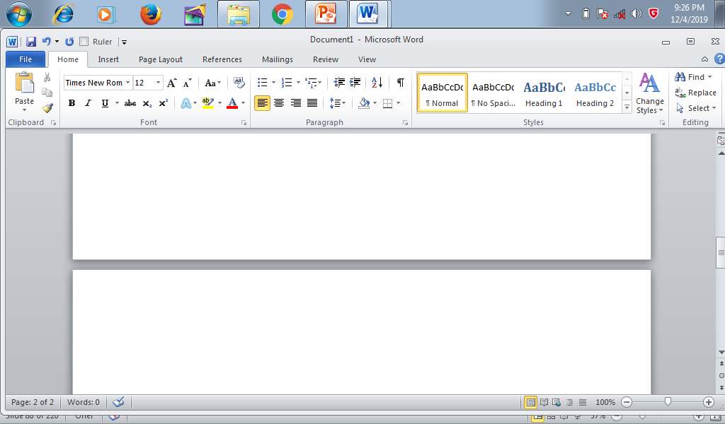
Figure 2: Project file showing two pages

Slide 84
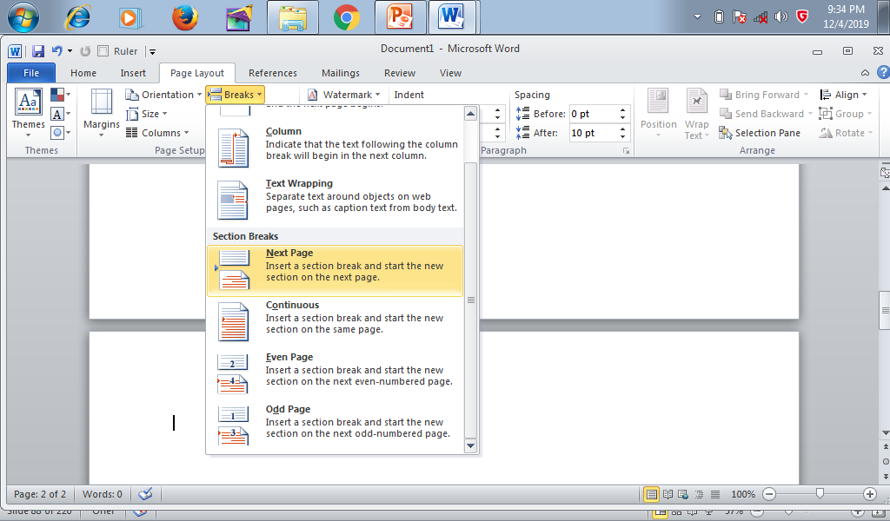
Figure 3: Inserting page break

Slide 85
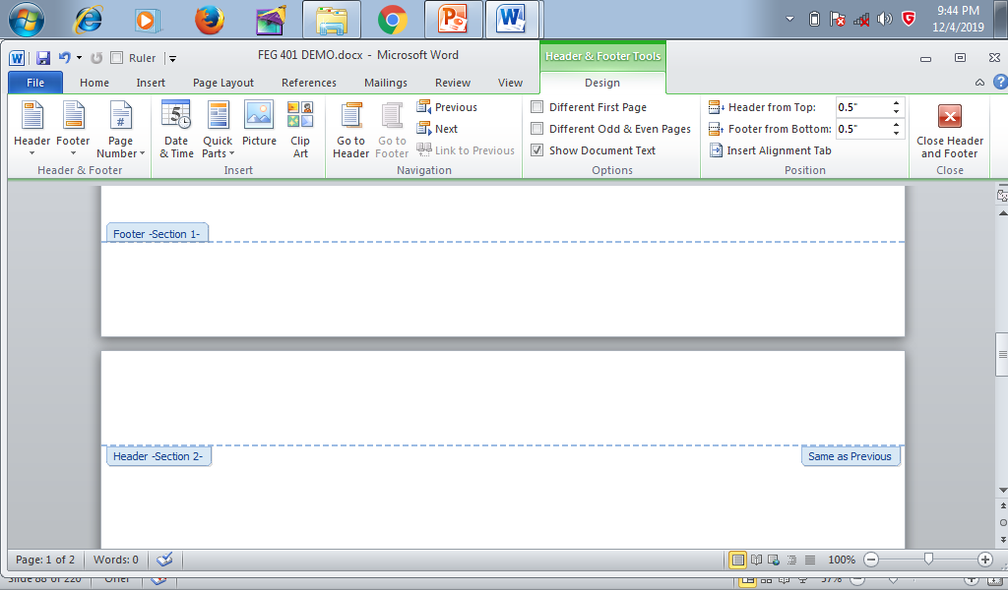
Figure 4: Confirmation of page break

Slide 86
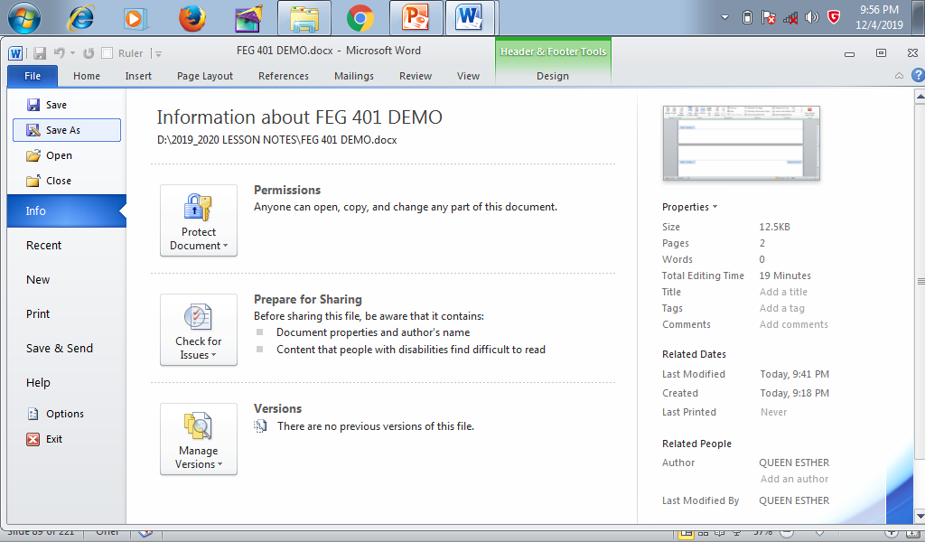
Figure 5: Saving a file

Slide 87
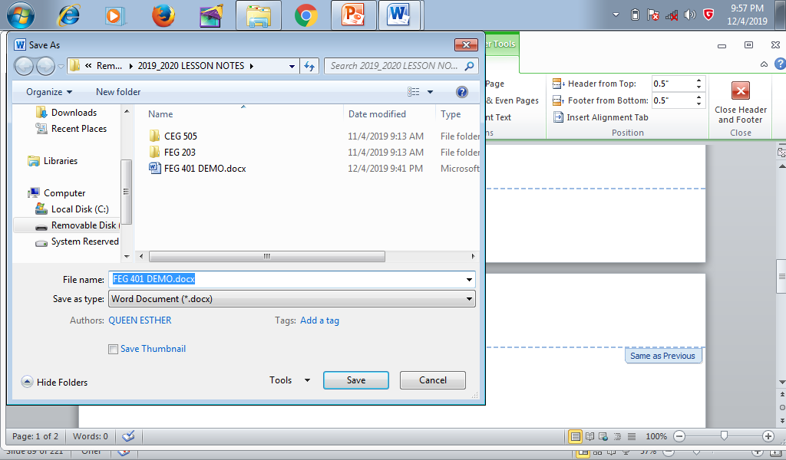
Figure 6: Saving a file

Slide 88
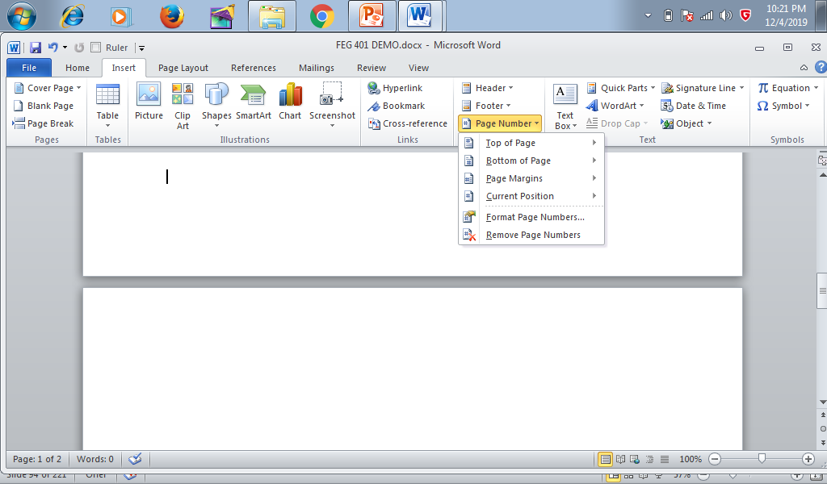
Figure 7: Preliminary page numbering

Slide 89
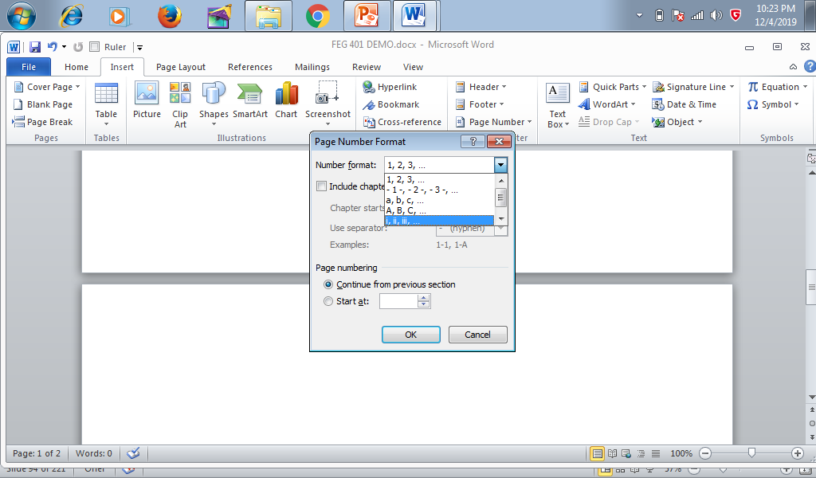
Figure 8: Formatting preliminary page numbering

Slide 90
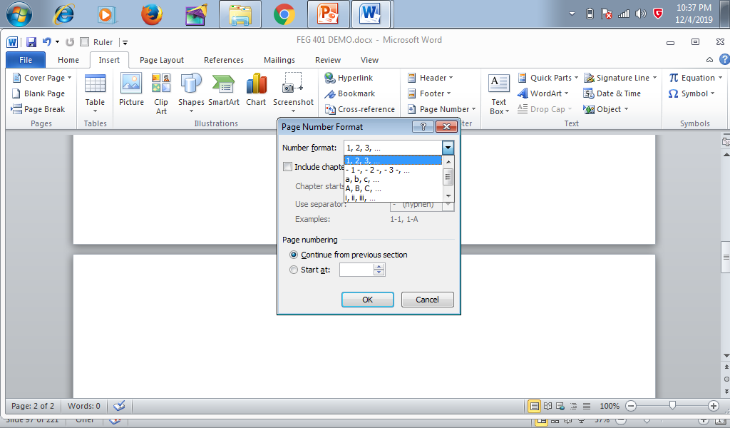
Figure 9: Formatting main pages

Slide 91
PRESENTATION OF CHARTS
A Chart is a graphical representation of data, in which “the data is represented by symbols, such as bars in a bar chart, lines in a line chart, or slices in a pie chart”. A chart can represent tabular numeric data, functions or some kinds of qualitative structure and provides different info (source: www.quora.com)
Graph: a diagram showing the relationship between variable quantities, typically of two variables, each measured along one of a pair of axes at right angles.

Slide 92
PROCEDURE FOR PREPARING A CHART
Open an excel file
Import your table (or input data for your table)
Choose the chart type under “insert” (Figure 10)
Choose the data (Figure 11)
NOTE: TO BE DEMONSTRATED IN CLASS

Slide 93
PROCEDURE FOR PREPARING A CHART
Source: David et al (2019)

Slide 94
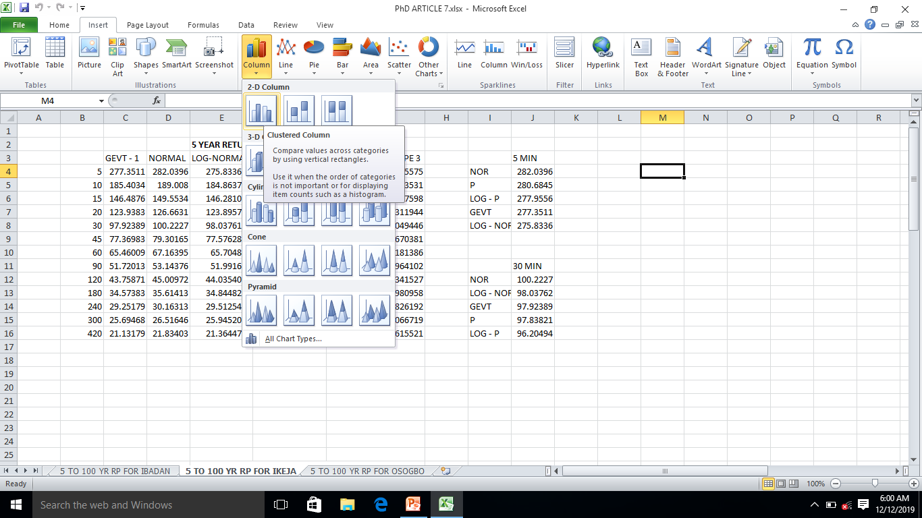
Figure 10: Choosing chart type

